Slide 1

Employee payroll DATABASE MANAGEMENT SYSTEM using
MD Saif Alvi
Roll: 1909013

Slide 2
AGENDA
The employee payroll database system allows the company management to manage, alter, update and calculate the payslip of their employees using ORACLE database system.

Slide 3
ER Diagram
E id
Email
E_name
Hire
Date
E id(FK)
Salary id
Receives
Dept
Bonuses
Position
Employee
Salary
Address
Contact
Deductions
Basic
Salary
Month
Applies
Views
Payslip id
E id(FK)
Leave id
Reason
Month
E id(FK)
Leave
Status
Pay slip
Insurance
Basic
Salary
Start
Date
Total
Days
Tax
Bonuses
End
Date
Deductions

Slide 4
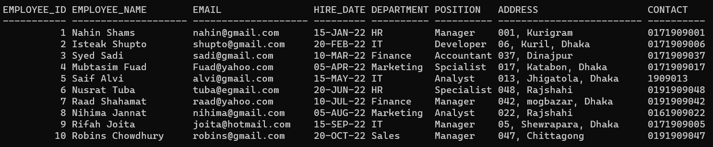
Employee table
Code:
CREATE TABLE EMPLOYEE (
EMPLOYEE_ID NUMBER PRIMARY KEY,
EMPLOYEE_NAME VARCHAR2(20),
EMAIL VARCHAR2(20),
HIRE_DATE DATE,
DEPARTMENT VARCHAR2(10),
POSITION VARCHAR2(10),
ADDRESS VARCHAR2(25),
CONTACT VARCHAR2(10)
);
After inserting 10 values we get:

Slide 5
Employee table
EMPLOYEE_ID (Primary Key): A unique numerical identifier assigned to each employee, facilitating quick and unambiguous identification.
EMPLOYEE_NAME: The full name of the employee, comprising both first and last names.
EMAIL: The primary email address of the employee, serving as a vital contact point.
HIRE_DATE: The date when the employee officially commenced employment with the company.
DEPARTMENT: Specifies the department or functional area within the organization where the employee is assigned.
POSITION: Describes the specific role, job title, or position that the employee holds.
ADDRESS: The physical address of the employee, providing location details.
CONTACT: The contact number, usually a phone number, for direct communication with the employee.

Slide 6
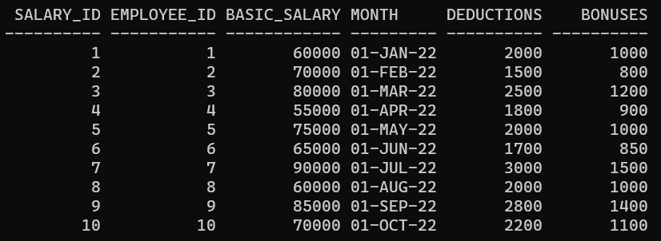
Salary table
Code:
CREATE TABLE SALARY (
SALARY_ID NUMBER PRIMARY KEY,
EMPLOYEE_ID NUMBER REFERENCES EMPLOYEE(EMPLOYEE_ID),
BASIC_SALARY NUMBER,
MONTH DATE,
DEDUCTIONS NUMBER,
BONUSES NUMBER
);
After inserting 10 values we get:

Slide 7
Salary table
SALARY_ID (Primary Key): A unique identifier assigned to each salary record, aiding in precise record-keeping.
EMPLOYEE_ID (Foreign Key): Establishes a connection to the EMPLOYEE table, linking each salary entry to a specific employee.
BASIC_SALARY: The core compensation amount, excluding bonuses or deductions.
MONTH: Specifies the month for which the salary details are recorded.
DEDUCTIONS: Captures any deductions or withholdings from the employee's salary, such as taxes, contributions, or other deductions.
BONUSES: Reflects any additional compensation provided to the employee beyond the basic salary.

Slide 8
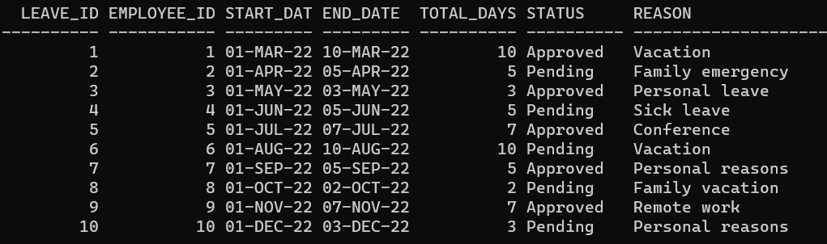
Leave table
Code:
CREATE TABLE LEAVE (
LEAVE_ID NUMBER PRIMARY KEY,
EMPLOYEE_ID NUMBER REFERENCES EMPLOYEE(EMPLOYEE_ID),
START_DATE DATE,
END_DATE DATE,
TOTAL_DAYS NUMBER,
STATUS VARCHAR2(10) DEFAULT 'Pending',
REASON VARCHAR2(20)
);
ALTER TABLE LEAVE ADD CONSTRAINT CHECK_END_DATE_AFTER_START_DATE CHECK (END_DATE > START_DATE);
After inserting 10 values we get:

Slide 9
Leave table
LEAVE_ID (Primary Key): A unique identifier assigned to each leave request, ensuring uniqueness in the leave records.
EMPLOYEE_ID (Foreign Key): Links to the EMPLOYEE table, associating each leave entry with a specific employee.
START_DATE: The commencement date of the requested leave period.
END_DATE: The concluding date of the requested leave period.
TOTAL_DAYS: Quantifies the total number of days requested for the leave, providing a duration for the absence.
STATUS: Indicates the status of the leave request, with possible values such as 'Pending,' 'Approved,' or 'Rejected.'
REASON: Elaborates on the reason or purpose behind the employee's request for leave.

Slide 10
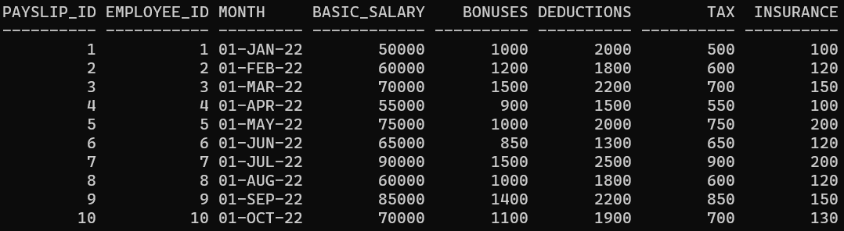
PAyslip table
Code:
CREATE TABLE PAYSLIP (
PAYSLIP_ID NUMBER PRIMARY KEY,
EMPLOYEE_ID NUMBER REFERENCES EMPLOYEE(EMPLOYEE_ID),
MONTH DATE,
BASIC_SALARY NUMBER,
BONUSES NUMBER,
DEDUCTIONS NUMBER,
TAX NUMBER,
INSURANCE NUMBER
);
After inserting 10 values we get:

Slide 11
PAyslip table
PAYSLIP_ID (Primary Key): A unique identifier assigned to each payslip, facilitating individual payslip retrieval.
EMPLOYEE_ID (Foreign Key): Links to the EMPLOYEE table, associating each payslip with a specific employee.
MONTH: Specifies the month for which the payslip is generated, offering a time reference for the salary details.
BASIC_SALARY: The fundamental salary component, representing the fixed amount paid to the employee.
BONUSES: Accounts for any supplementary payments or bonuses provided to the employee.
DEDUCTIONS: Encompasses various deductions from the employee's salary, such as taxes, contributions, or other withholdings.
TAX: Specifies the exact amount of tax deducted from the employee's salary.
INSURANCE: Represents the amount deducted for insurance coverage, if applicable.

Slide 12
Net Pay=Basic Salary+Bonuses −Deductions−Tax−Insurance
To calculate net salary,

Slide 13
Calculating net pay
SQL query to retrieve the net pay for each employee:
SELECT
E.EMPLOYEE_ID,
E.EMPLOYEE_NAME,
S.BASIC_SALARY,
S.BONUSES,
S.DEDUCTIONS,
P.TAX,
P.INSURANCE,
(S.BASIC_SALARY + S.BONUSES - S.DEDUCTIONS - P.TAX - P.INSURANCE) AS NET_PAY
FROM
EMPLOYEE E
JOIN SALARY S ON E.EMPLOYEE_ID = S.EMPLOYEE_ID
JOIN PAYSLIP P ON E.EMPLOYEE_ID = P.EMPLOYEE_ID;

Slide 14
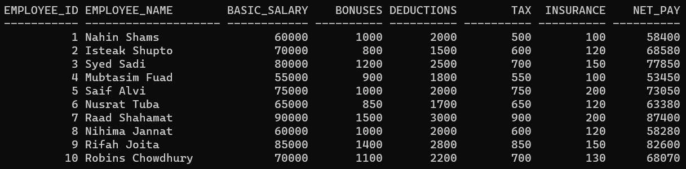
Calculating net pay
Here, we inner join three tables which are EMPLOYEE, SALARY and PAYSLIP to retrieve various informations about an employee and to calculate the net salary of that employee.
After this query we get:
Here we can observe the last column which gives us the calculated net salary.

Slide 15
SUMMARY
This Payroll Management System offers a robust solution for handling employee-related data, salary administration, leave requests, and payslip generation, contributing to more efficient and organized HR processes within an organization.

Slide 16
THANK YOU
MD Saif Alvi
Roll: 1909013
Semester: 3-2
Dept of ECE, KUET

